Slide 1




Conflict resolution that works
Notes:
Trainer’s notes
HOW THE NOTES WORK
The notes are meant to help you with the pace and flow of the module.
Remember, it’s an espresso training session. Keep the train running; it can slow down for a bit but never stop.
Notes in “quotation marks” are what you want say to the audience. Feel free to paraphrase.
Notes without quotation marks are for your eyes only. Instructions, background, tips and case studies (which you might use).
Good luck!
DURATION
90 minutes if you keep delegates focused.
ROOM AND SETUP
Ideally use a room with lots of natural light.
Set up the room café style: tables with four participants.
Play music at the start and during breaks. Music encourages people to talk.
Have flipcharts and fresh markers for each table.
STYLE
Fast-paced and practical.
Warmly greet people when they enter the room.
Use a parking lot for tricky questions. Announce it at the start. Chances are you won’t have to use it but it can prevent long diversions.
Mix up participants for each exercise.
TIPS
Be in a good state of mind and well rested.
When you are presenting, distribute your weight equally on your two feet. Don’t slouch.
Never talk for more than ten-minutes without a pause or interaction.
Start at a brisk pace. You can’t make up for lost time later on.
Love your audience:
Know the material so well that you can focus on the participants in the room.
Before you start each section, know what you want participants to learn, feel and do.
Keep to time. If you can’t, don’t blindly stick to your slides. It hurts our hearts(!), but you may have to skip slides if time has slipped away.

Slide 2



https://nearpod.com/student
Joining code: QNMDB

Slide 3


Slide 4


Intense
Timed
Tasters
Notes:
What is the main advantage of drinking espresso instead of americano? It takes less time.
These four sessions are like drinking shots of espresso.
First of all, it’s INTENSE. The content has been condensed from roughly four days into four small chunks to save busy managers’ time. Plus research shows that intense bursts of learning are just as effective as long training sessions.
The trade-off is that we will STRICTLY TIME all activities so that we can deliver the sessions in the short time allotted. Remember we will be learning just as much as if we spent all day discussing these frameworks and research.
The activities are meant to be TASTERS. If you only manage to go through three questions out of seven, that’s absolutely fine. The exercises will give you enough of a taster to get you started. It’s important to apply what you have learned right after the session, and we will support you.

Slide 6
Agenda
Resolving conflict
Mediating conflict resolution
Encouraging healthy conflict
Notes:
Trainer’s notes
Walk participants through the agenda

Slide 7
How does our company culture cope with conflict?
In my company, people treat one another with trust and mutual respect. 4.06
I can report unethical practices without fear of a negative impact on me. 4.05
Sufficient effort is made to get the opinions and thinking of people who
work here. 3.85
Source: Growing together survey. N=24,510. 2019.
Notes:
Trainer’s notes
“These are select questions from the AF employee survey.”

Slide 9
Conflict is beneficial
Avoiding interpersonal conflict can lead to festering resentments, passive-aggressive behavior and irreversible break-ups in relationships.
Lack of healthy disagreement in teams often leads to poor decision-making.
Without conflict people withdraw and become superficially harmonious – their engagement and performance suffer.
Notes:
Trainer’s notes
“Here are three reasons why avoiding healthy conflict could be damaging.”
Read the slide.
Comment on the second point: “Teams whose members challenge one another’s thinking develop a more complete understanding of the choices, create a wider range of options, and make more effective decisions.”

Slide 10
“The absence of conflict is not harmony, it’s apathy.”
Eisenhardt et all “How Management Teams Can Have a Good Fight”, HBR 1997
Notes:
Trainer’s notes
Read a quote on the slide.
Comment: “Alternative to healthy conflict is not agreement, but apathy and disengagement, even passive aggression) and as a result, lower performance.”

Slide 11

Resolving conflict
Notes:
Trainer’s notes
“Before we go into the techniques of conflict resolution, it’s really useful to first understand what’s going on when we are engaged in conflict.”

Slide 12

Think…
Reflect on your Thomas-Killman report. This is your most frequently used conflict mode?
Notes:
Trainer’s notes
“First, raise you hand if you find engaging in conflict easily.”
Now think about the questions on the slide. Work with your neighbour.”

Slide 13
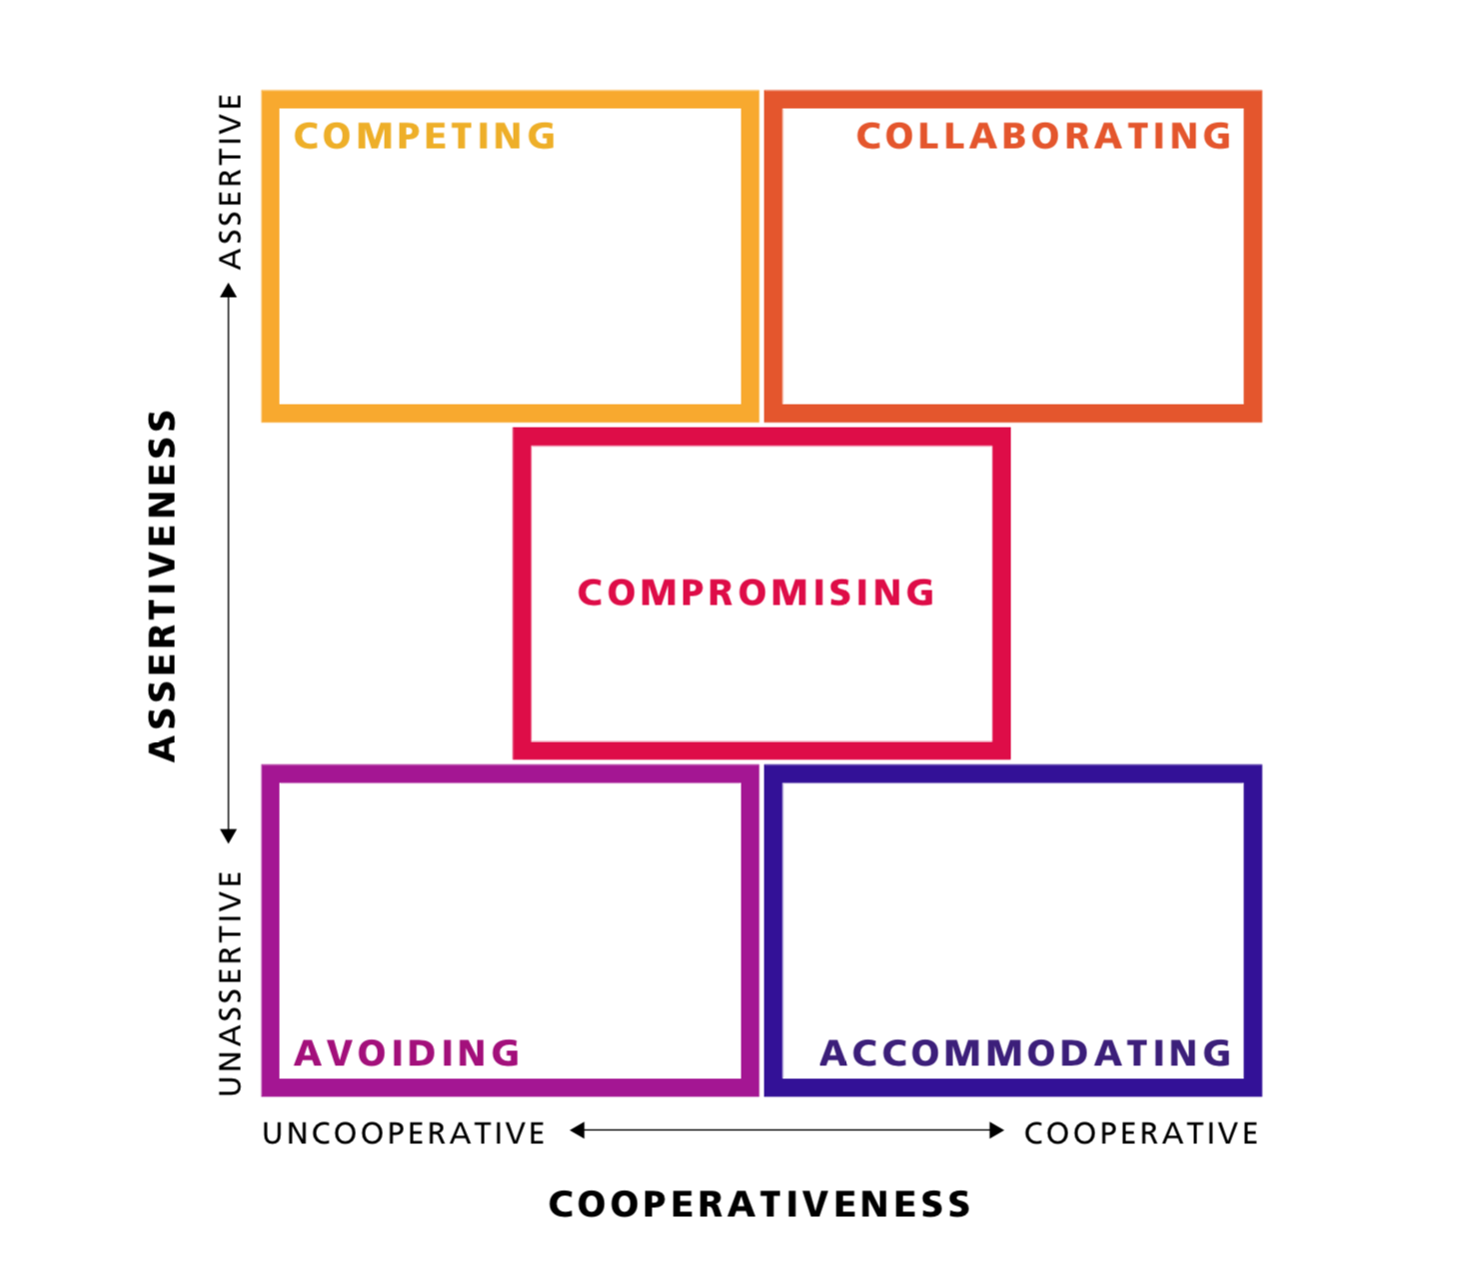
Thomas-Killman report
Notes:
Trainer’s notes
“This is how TKI works – you get five different styles of dealing with conflict using two dimensions – cooperativeness (High/Low) and assertiveness (High/Low).”

Slide 14

The battle
of messages
The battle
of messages
FACTS
FEELINGS
IDENTITY
Notes:
Trainer’s notes
“When we encounter people with differing interpretations of Facts, difficult Feelings and different impact on their Identity, the conversation can spiral down into the battle of messages.”

Slide 15
The battle
of messages
Learning conversation
Notes:
Trainer’s notes
“Our goal is to shift the mode towards a learning conversation.”

Slide 16

Resolving conflict
v
Sort out facts and feelings
Notes:
Trainer’s notes
“I am going to take you through the simple but highly effective framework of conflict resolution.”
“The first step is something you do BEFORE you have the conflict resolution conversation. What makes conflict difficult to resolve is that we have three different conversations going on in our heads at the same time. There is a conversation about facts, feelings, and identity. You prepare by sorting our FACTS, FEELINGS, AND IDENTITY issues.”

Slide 17
As and when you are engaged in a conflict with another.
Understand the FACTS: write down your side of the story
What is your side of the story?
What impact did it have on you?
What was your contribution?
Notes:
Trainer’s notes
“First, let’s deal with the FACTS.”
Read the slide.

Slide 18
Blame
Contribution
Judging
Understanding
Who is in the wrong?
How should we judge you against some standard of conduct?
How did we each contribute to the problem?
What can we do about it as we move forward?
Notes:
Trainer’s notes
“It brings us to the important distinction between BLAME and CONTRIBUTION.
Read the slide.
“Focusing on blame is a bad idea because it inhibits our ability to learn what’s really causing the problem and what to do about it to correct it.”
You can use your own example, or an example below:
“For example, the tub overruns and ruins the ceiling in the living room. Whose fault is it?
The husband who forgot to turn it off?
The wife who called the husband to come downstairs?
The manufacturer who designed the overflow drain too small?
The plumber who forgot to mention it?”
“Who contributed to the problem? All of the above. When you goal is fixing the ceiling, finding who to blame is a waste of time. Also it doesn’t help you to avoid it going forward.”
“There are a couple of hard-to-spot contributions:
Avoiding until now (i.e., a remark that you boss gives you just drives you crazy for years).
Being unapproachable/judgemental, unfriendly.”

Slide 19
Feelings: accept, regulate, express
Accept that your feelings are OK and write them down.
Be realistic: from eliminating fear and anxiety which helps in reducing them.
Prepare to express your feelings constructively.
Notes:
Trainer’s notes
“Next, you also need to deal with your FEELINGS.”
Read the first two bullets on the slide. Comment:
“Put a label on your emotion. Unfortunately, this is not something they teach you at school, and I very often meet fully grown up adults that have no ideal how they feel! Once you understand how you feel, write it down. Read it aloud to yourself or to a trusted friend.
Comment on the third bullet:
“Change your thinking: eliminating fear and anxiety is often impossible. Reducing them is more realistic.”
Comment on the fourth bullet:
“Expressing your feelings without becoming aggressive is entirely possible. This is what you need to do: express your feelings in the conversation by naming them, not giving them an emotional outburst.”

Slide 20

Express your feelings
“Engaging in a difficult conversation without talking about feelings is like staging an opera without the music. You’ll get the plot, but miss the point.”
Stone et al 2011.
Unexpressed feelings often leak into the conversation.
Notes:
Trainer’s notes
“By the way, let’s take a position here. It is really important to share how you feel. That flies into the face how often we (especially men) try to deal with conflict. We often say “Let’s not get emotional here.” However, it is nearly impossible.”
Read the slide.
“If you don’t express how you feel about the conflict, you risk that the other person WILL NOT FULLY UNDERSTAND how the situation affected you - and the situation will more likely to repeat itself. We are emotional, not just purely rational beings.”
Additional comment:
“Sometimes instead of expressing feelings honestly, we hide them behind:
Character judgments: “You are so inconsiderate.”
Attributions of intent: “Why were you trying to hurt me?”
Problem-solving: “The answer is for you to call me more often.”

Slide 21
Think…
about a conflict you are currently engaged in or need to deal with
Type in:
1. The facts:
what happened
the impact it had on you
your contribution.
2. The feelings you experienced.
Lets share on nearpod.
Notes:
Trainer’s notes
Read the slide, conduct the exercise.

Slide 23

Resolving conflict
v
Sort out facts and feelings
v
Explore
both stories
Notes:
Trainer’s notes
“The next step is to have a conflict resolution conversation. You start it by exploring both stories.”

Slide 24
Explore both stories
Open the conversation by stating you’d like to share your perspective on the situation and hear the other person’s perspective as well.
Share your version of the facts and the impact the conflict has had on you.
Now ask them to share their story. Really listen and try to understand the other person’s perspective. Paraphrasing helps.
Do not assume they meant to hurt you. Ask the other person about their intentions.
If appropriate, acknowledge your contribution.
Notes:
Trainer’s notes
Read the slide.

Slide 25
My story is more important | Let’s explore both stories
“Honey, we need to talk about your problem with washing the dishes” | “Honey, you and I seem to have different preferences about when the dishes get done. Can we please talk about it?”
“You shouldn’t have said that in front of the CEO!” | “I wanted to talk to you about what happened in the meeting this morning. I was upset by something you said. I wanted to explain what was bothering me and to hear you perspective on the situation.”
Notes:
Trainer’s notes
“Here are a couple of examples of engaging in the conflict resolution conversation from two perspectives. Which one do you think is going to work better?”

Slide 26

Resolving conflict
v
Sort out facts and feelings
v
v
Explore
both stories
Acknowledge each other’s feelings
Notes:
Trainer’s notes
“The next step is to make sure you acknowledge each other’s feelings. Here is how you do it.”

Slide 27
Acknowledge each other’s feelings
Express your feelings without judging or blaming. Use the “I” statements.
Then ask your counterpart to share theirs. If your counterpart struggles to express how they feel, gently label their emotions:
It sounds like you were disappointed in what I did.
It sounds like you were worried that we wouldn’t make the deadline.
It seems like you were reluctant to discuss it in the room.
Notes:
Trainer’s notes
Read the slide.

Slide 28
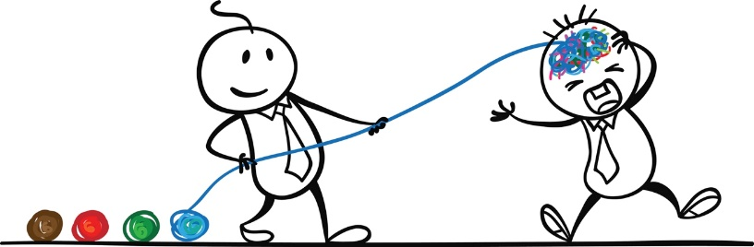
Resolving conflict
v
Sort out facts and feelings
v
v
v
Explore
both stories
Acknowledge each other’s feelings
Reframe, reframe, reframe
Notes:
Trainer’s notes
“The next principle of successful conflict resolution is reframing throughout the conversation.”

Slide 29
Reframe, reframe, reframe
Reframing is a technique you can use if the other person becomes combative. Take the essence of what they are saying and translate it into concepts that are more helpful.
Notes:
Trainer’s notes
Read the slide.
“Remember, the other person may not be as skilled in the conflict resolution (as you are now ☺), so help them to gently to get out of the ‘blaming’ mindset.”

Slide 30
They… | You reframe
Scream at you. | “You can yell at me and I can yell back at you but this isn’t going to solve our problem. Let’s try to see how we might fix this.”
Say: “I’m absolutely right, and there are no two ways about it.” | “I want to make sure I understand your perspective. You obviously feel very strongly about it. I’d also like to share my perspective on the situation.”
Say: “You hurt me on purpose!” | “I can see that you are feeling really angry about what I did, which is upsetting to me. It wasn’t my intention. Can you say more about how you feel?”
Say: “This is all your fault!” | “I’m sure I’ve contributed to the problem; I think we both have. Rather than focus on whose fault it is, I’d just like to discuss what we each contributed to the situation.”
Notes:
Trainer’s notes
“Here is what you can do if their response becomes unproductive.”
Read the slide.

Slide 31

Resolving conflict
v
Sort out facts and feelings
v
v
v
v
Explore
both stories
Acknowledge each other’s feelings
Reframe, reframe, reframe
Find a way
forward
Notes:
Trainer’s notes
“Finally, end the conversation by trying to find a way forward that would work for both of you.”

Slide 33
Invent options that will work for both of you
Discuss more than one option.
Let’s think of a few solutions and explore the pros and cons together.
Look at each solution from both sides.
How well would this work from your perspective?
Choose an option that works for you both, even if it involves some compromise.
Notes:
Trainer’s notes
Read the slide.

Slide 34
Close on a constructive note
Decide who is responsible for what part of the solution.
Agree how you will communicate about the issue.
Affirm the relationship.
Notes:
Trainer’s notes
Read the slide.

Slide 35
Think…
about a conflict you are currently engaged in or need to engage in. Prepare to role-play the situation with a partner.
Try to:
explore both stories
acknowledge each other’s feelings
reframe if they become combative
decide on a way forward together.
Remember to agree how you will communicate, and affirm the relationship.
Notes:
Trainer’s notes
Facilitate the exercise.

Slide 36

Mediating conflict resolution
Notes:
Trainer’s notes
“Now, let’s talk about how we can effectively mediate conflict resolution – for example, if you have two team members that have a visible conflict.”

Slide 37
What do you do if your team members are in conflict,
but they are unwilling to solve it?
Notes:
Trainer’s notes
“Before we talk about techniques, I’d like to hear your thoughts about a question on the slide.”
Collect opinions.

Slide 39
Mediate healthy conflict
v
Ask them to sort out facts and feelings
v
v
v
v
Help them to explore both stories
Encourage them to acknowledge each other’s feelings
Reframe, reframe, reframe
Coach them to find a way
forward
Notes:
Trainer’s notes
“The good news is that we don’t have to invent another framework for conflict mediation. We can simply adjust the one we used in the first part of this training.”
Read the framework from the slide.

Slide 40
Set the right tone
Establish the purpose of the meeting and set ground rules
confidentiality
ensure the willingness of both parties to seek resolution
invite them to openly express opinions with each other and discuss the problem without attacking personalities.
Establish your role as a mediator
you will facilitate the conversation but they have to solve the conflict
you will redirect the parties if they break the ground rules.
Notes:
Trainer’s notes
“Here is what you can do once you got the two parties in the room together. First, set the right tone for the conversation.”
Read the slide.

Slide 41
Facilitate the conversation
Ask both parties to write down the facts and their contribution.
Help each party to share the facts and the impact without interruption.
Encourage both parties to express their feelings and to acknowledge the other person’s emotions.
Reframe, reframe, reframe.
Coach the parties to find a way forward. Only ask questions in hopes they find their own solution!
Notes:
Trainer’s notes
“Next, facilitate the conversation.”
Read the slide.

Slide 42
Things to remember within mediating conflict resolution.
The mediator should try to:
set ground rules
help both parties share and explore their sides of the story
encourage both parties to express their feelings and to acknowledge the other person’s emotions
reframe the discussion if the conflict becomes unconstructive
coach them to find a way forward together.
Practice makes perfect.
Notes:
Trainer’s notes
“Now, let’s practice.”
Facilitate the exercise as described on the slide.
Give people a choice – they can either role play a real situation in their team, or simply use a scenario on the next slide.

Slide 43
Scenario for mediating conflict
Ahmed and Khalil are part of your customer service team. Ahmed has more seniority and experience and keeps giving Khalil unsolicited advice on how to handle customer requests. Khalil is growing increasingly resentful because he feels Ahmed is acting like more like his boss than a colleague. His conversations with Ahmed become more and more abrupt, bordering on rude. Ahmed is upset because he feels he just wants to help. The conflict starts affecting the entire team. You’ve talked to both men and they agreed to meet with you for mediation.
Notes:
Trainer’s notes
Provide this scenario to the participants in case they don’t have their own situation to role play.

Slide 44

Encouraging healthy conflict
Notes:
Trainer’s notes
“Finally, as we said at the beginning of the session, not all conflict is bad or difficult. How do we encourage healthy conflict? Here are three simple but effective strategies how you could do it with your team.

Slide 45

Brainstorm silently
before you join forces
Have each person write down their ideas independently to avoid groupthink.
Collect ideas on a flipchart and read them out loud without making any judgments.
Only then debate and build on each other’s ideas.
Notes:
Trainer’s notes
“Let’s discuss three ways of encouraging healthy conflict in your team.”
First, whenever you brainstorm as a team, brainstorm independently first before you join forces. It is important because during regular brainstorming the most confident or opinionated person often speaks first and anchors the conversation, making it more difficult for the different opinions to come to surface. Here is how you do it.”
Read the slide.

Slide 46

Appoint a devil’s advocate
Appoint a devil’s advocate
Before brainstorming, appoint a devil’s advocate. They shouldn’t participate in brainstorming, they should only observe.
After the group comes up with a plan, allow the devil’s advocate to punch holes in what has been agreed.
Rotate the role.
Notes:
Trainer’s notes
“The second tool you can use is appointing devil’s advocate. By doing that you normalise disagreement. As a result, important loopholes in your plan will be surfaced before it’s too late.”
Read the slide.

Slide 47

Conduct a pre-mortem
After your team comes up with a plan, envision all the ways things could go wrong. It’s a year from now. Our project failed. Why?
Agree the three most likely reasons why the project might fail.
Put together a plan to mitigate things going wrong or revisit your plan.
Notes:
Trainer’s notes
“Finally, use pre-mortem. This tool is particularly useful when planning ahead and it tackles our overconfidence bias.”
Read the slide.

Slide 48
Which of the three methods of creating healthy conflict will you try with you team?
How will you position it?
Let us share on nearpod.
Notes:
Trainer’s notes
Facilitate the discussion in groups, then ask to share back briefly.

Slide 50

Its time for a QUIZ!

Slide 51
One-page summary
Notes:
Trainer’s notes
“In conclusion of our session today, remember that training has very little impact unless it’s followed through on a regular basis. To help you, we designed two tool for your immediate use.”
First, we will send you a one-page summary you can refer to when dealing with conflict.

Slide 52
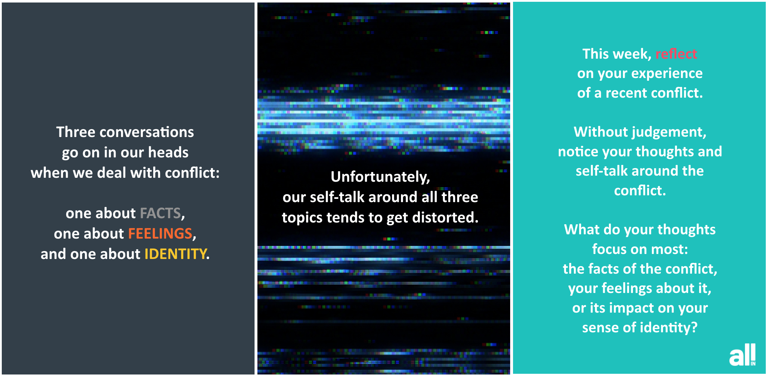
Weekly nudges
Notes:
Trainer’s notes
“Second, every week we will be sending you a little nudge to encourage you to apply what you’ve learnt during the session. There will be 8 nudges in total; here is an example of one of them.”

Slide 54
Closing comments
Notes:
Trainer’s notes
Ask for closing comments and close the session.

